Slide 1

Senior Project Management System for International School
Capstone 2

Slide 2
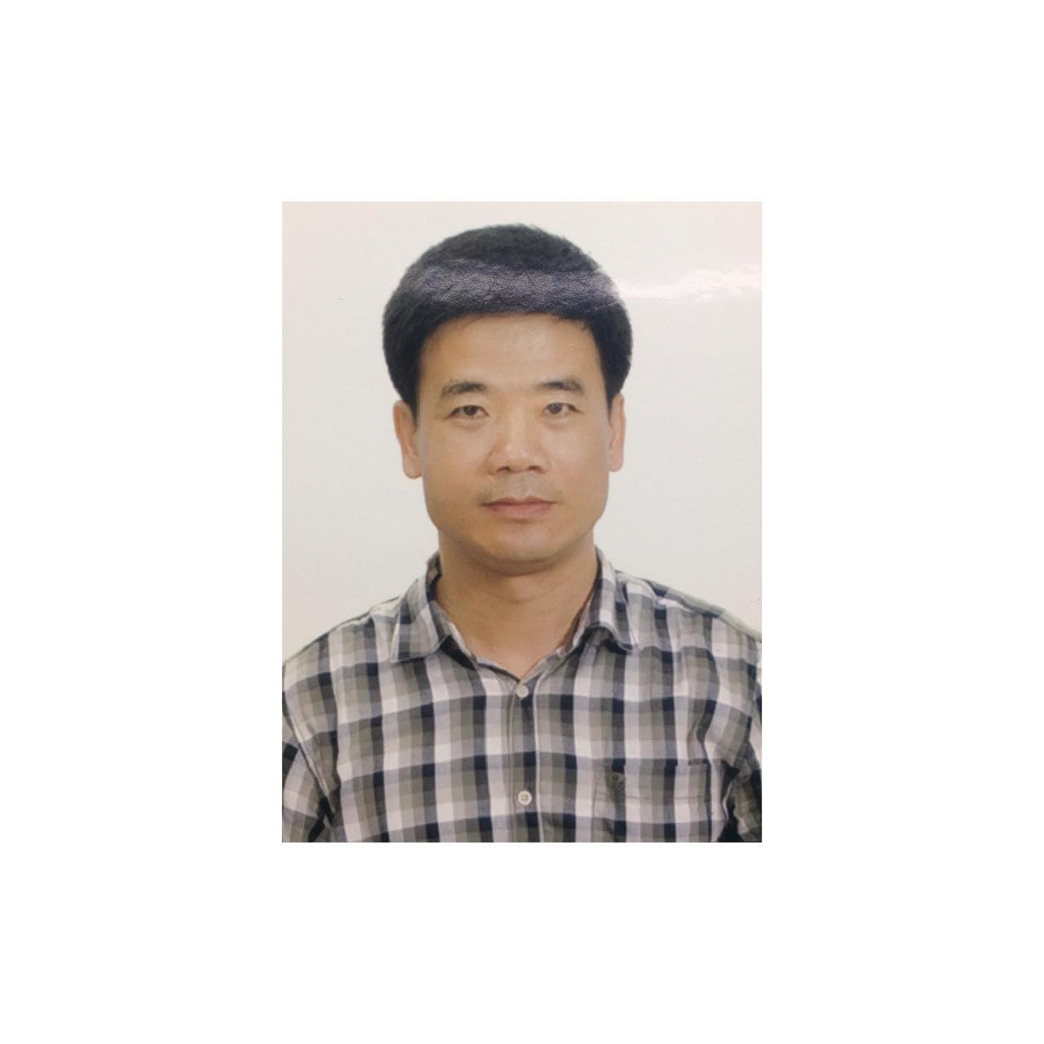




C2SE.23
Truong Ngoc Chau Mentor
Nguyen Van Tien Scrum Master
Truong Dong Huy Developer
Ha Duc Phuoc Product Owner
Nguyen Thanh Dat Developer

Slide 3
Contents
1
5
Business Problem
Project Management
2
6
Solution
Reflection
3
7
Architecture
Demo
4
Technologies

Slide 4
Business Problem
1

Slide 5
Business Problem
Currently, it becomes difficult for students to manage project implementation and students find it difficult to grasp and understand the process.
The faculty uses google forms to collect student information and uses excel to store student information, mentors, registered topics, and timelines for projects.

Slide 6
Solution
2

Slide 7
Solution
Easily register to participate, implement the project and collect student information quickly and save time.
Faculty will easily divide groups, mentors, and topics for students. Mentors and students will easily connect together.
The Moderator will easily divide the schedule for the project council sessions. Students can easily receive the schedule.

Slide 8
Architecture
3

Slide 9
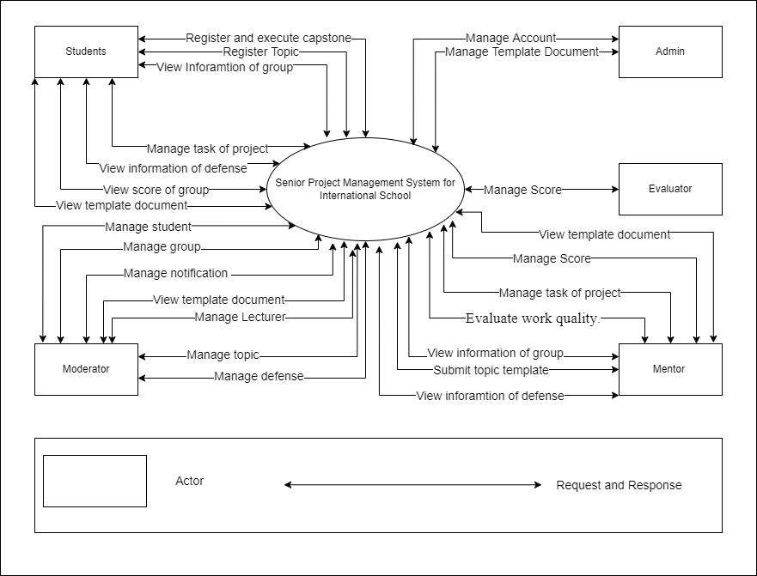
System Context Diagram

Slide 10
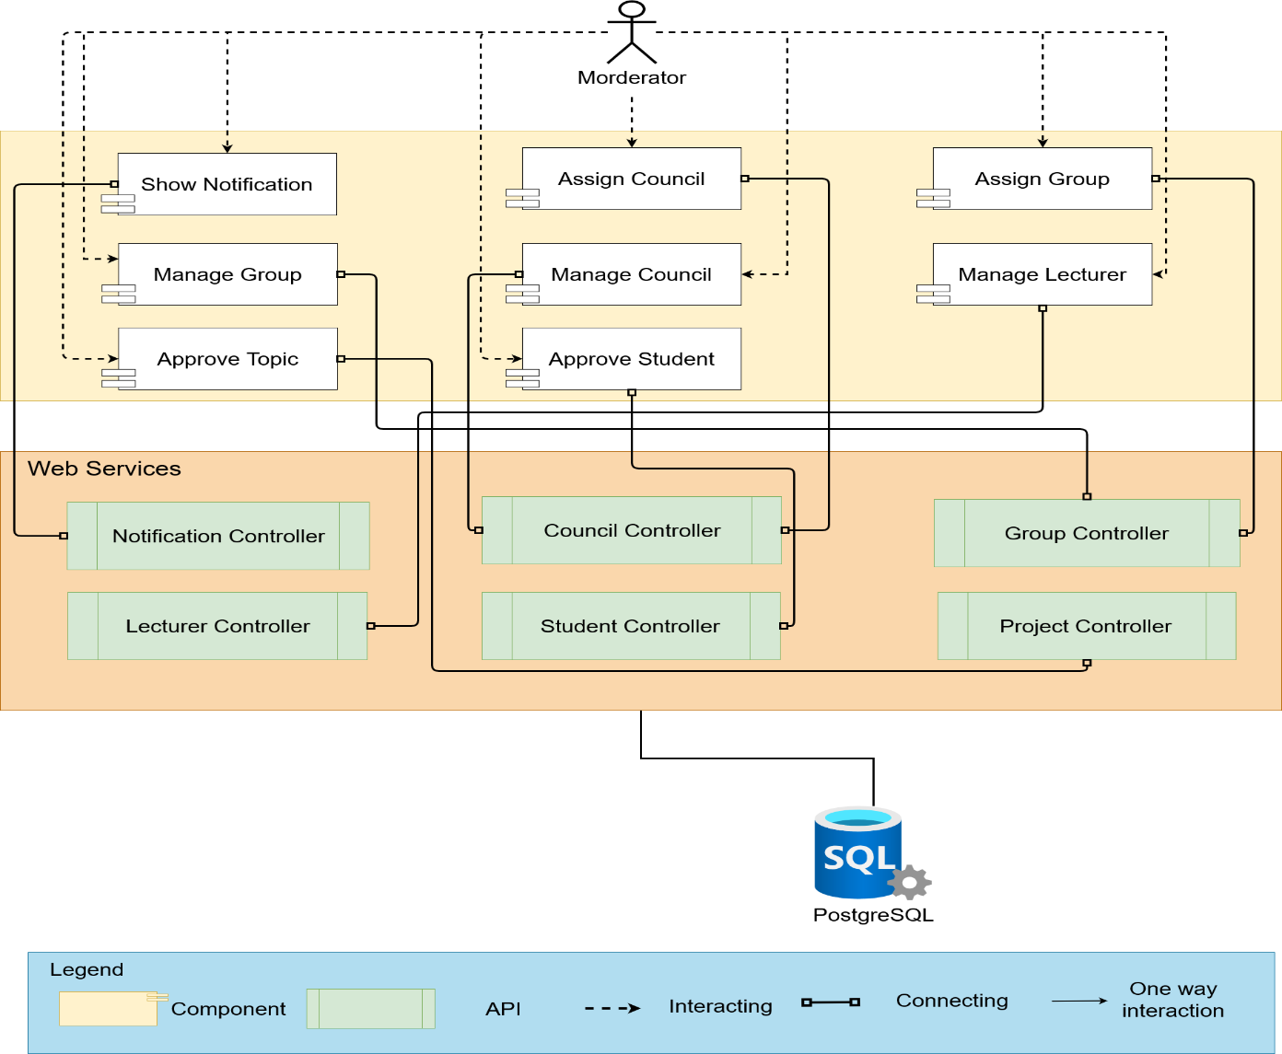
Component & Connector (Moderator)

Slide 11
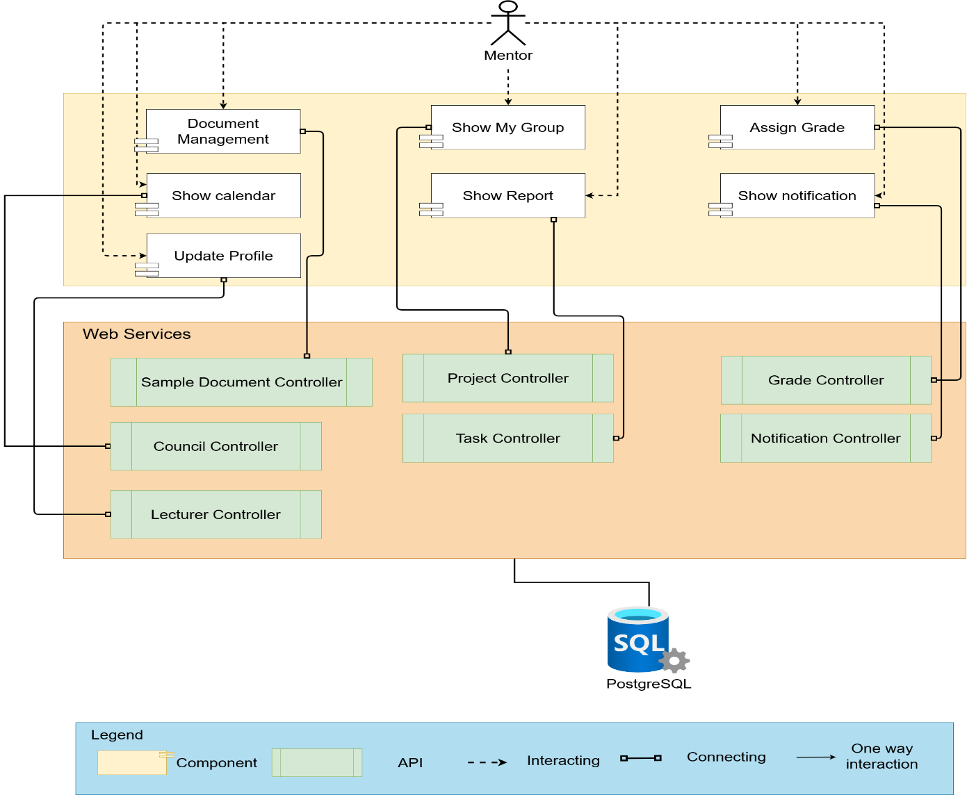
Component & Connector (Mentor)

Slide 12
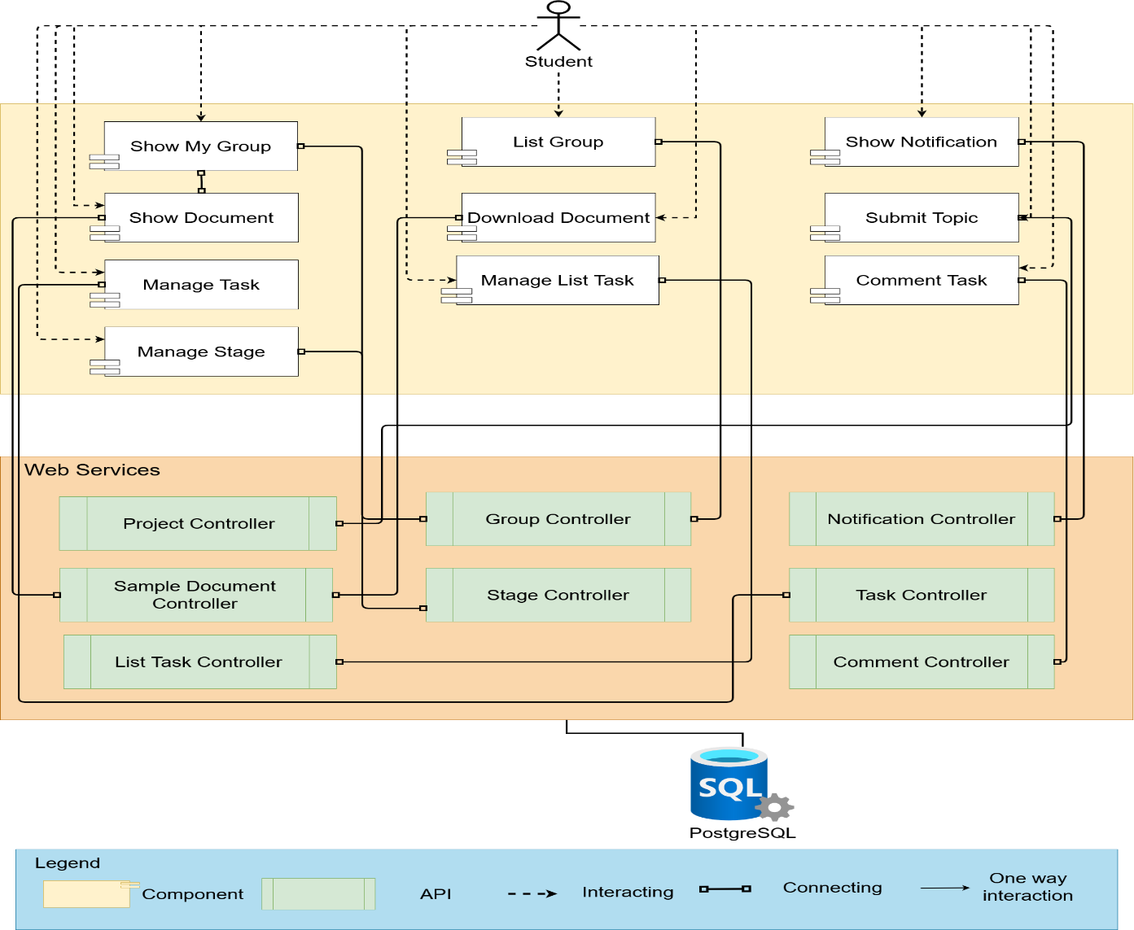
Component & Connector (Student)

Slide 13
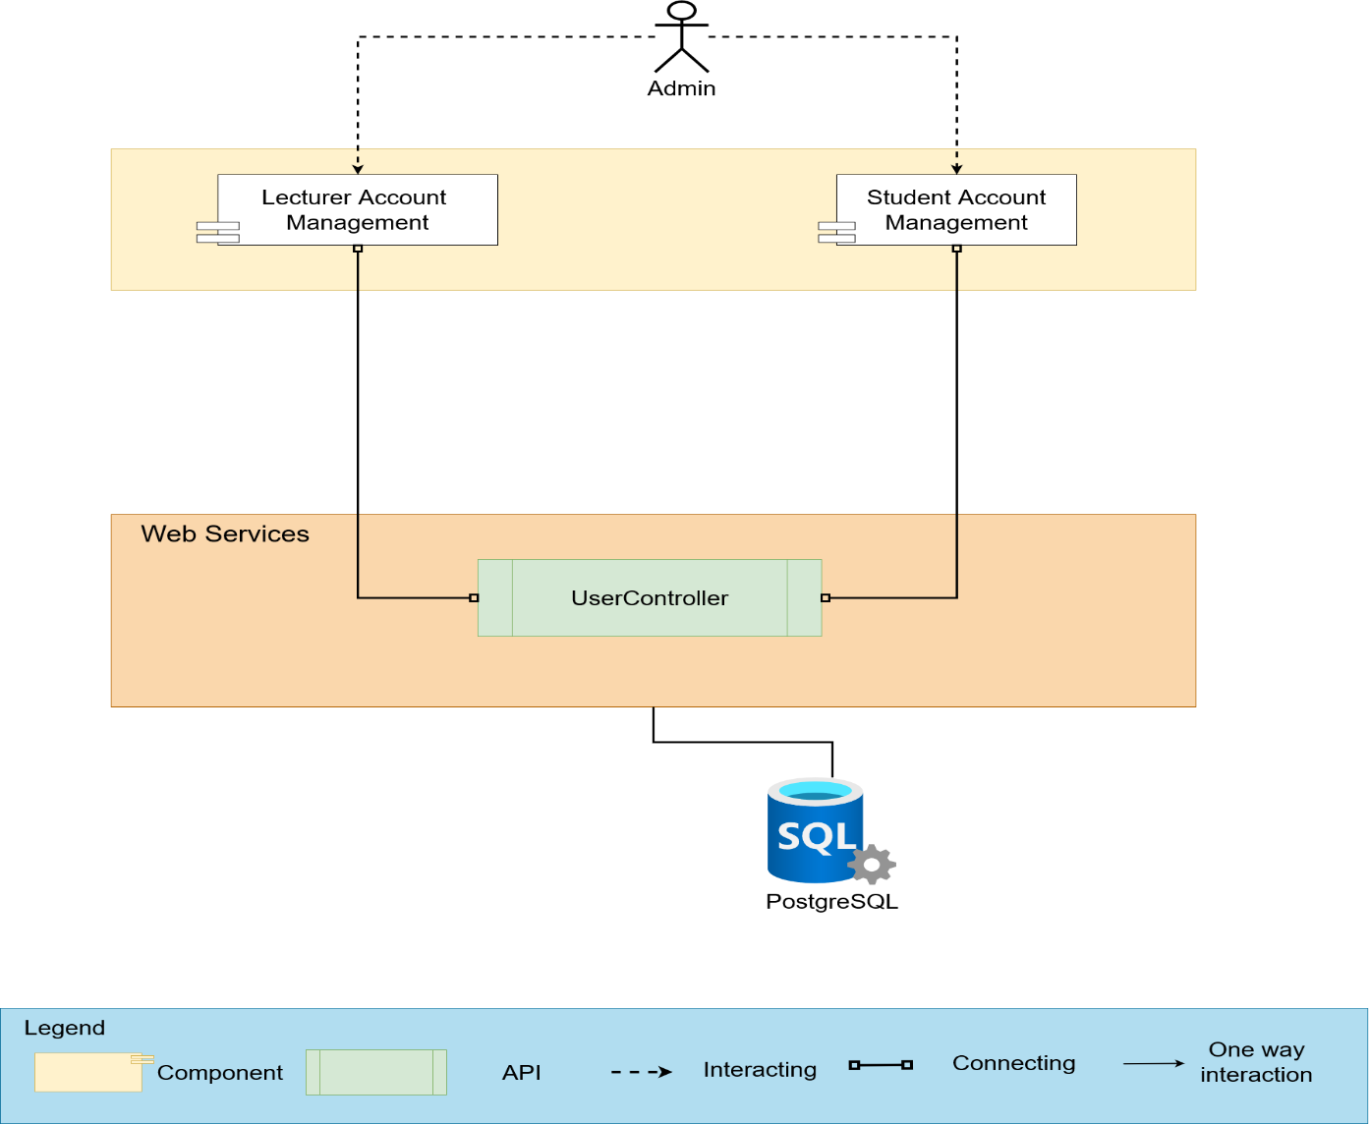
Component & Connector (Admin)

Slide 14
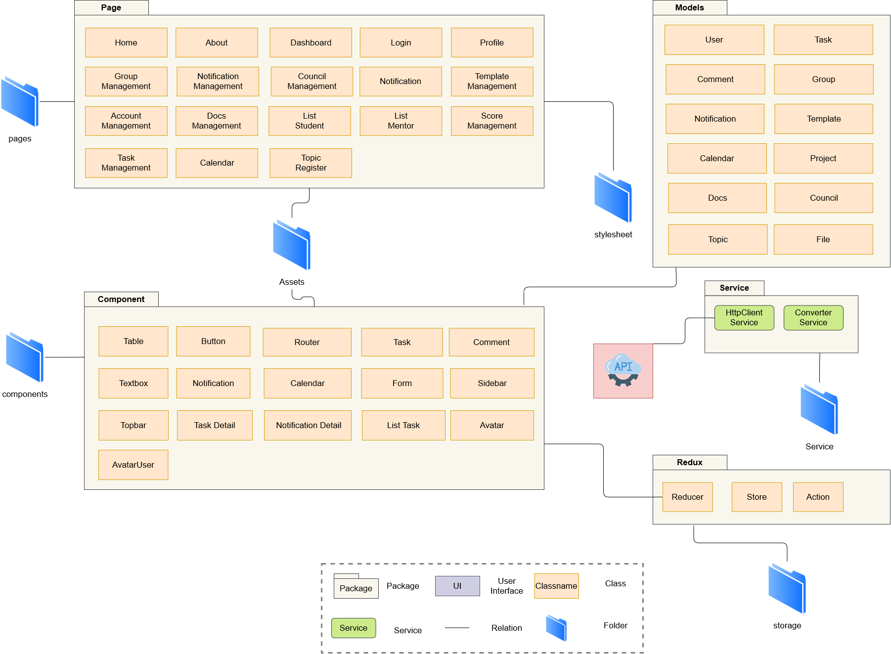
Module View ( Client )

Slide 15
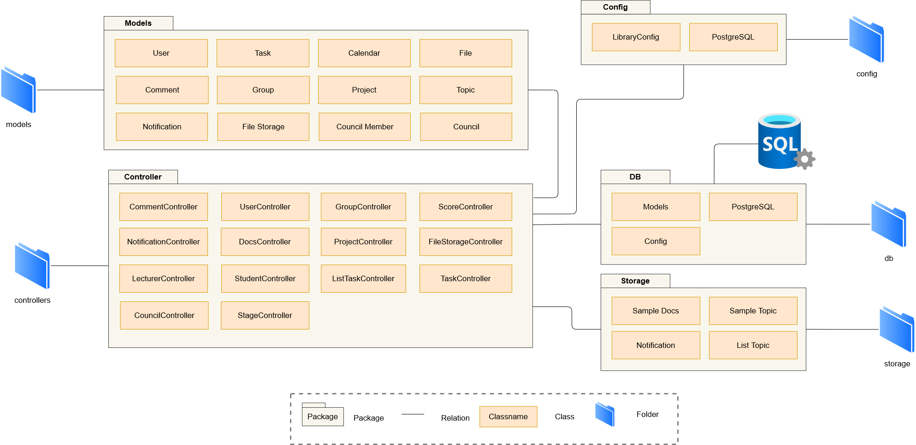
Module View ( Server )

Slide 16
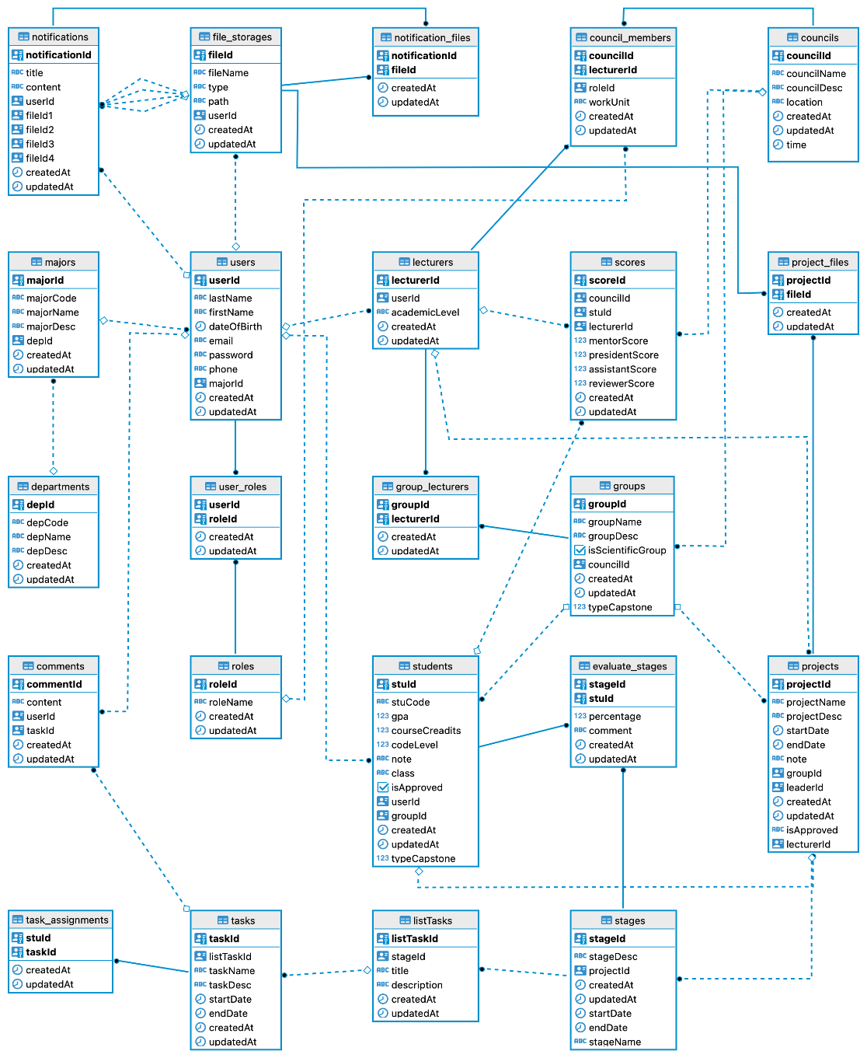
Database

Slide 17
Technologies
4

Slide 18








Client
HTML
React
Redux
Material UI
Day 3
JavaScript
Axios
Sass
Bootstrap

Slide 19





Server
Node JS
PostgreSQL
Postman
Javascript
Sequelize

Slide 20




Meeting and Management
Source Version
Control
Manage Tasks
& Project Progress
Daily Meeting & Work Discussion

Slide 21
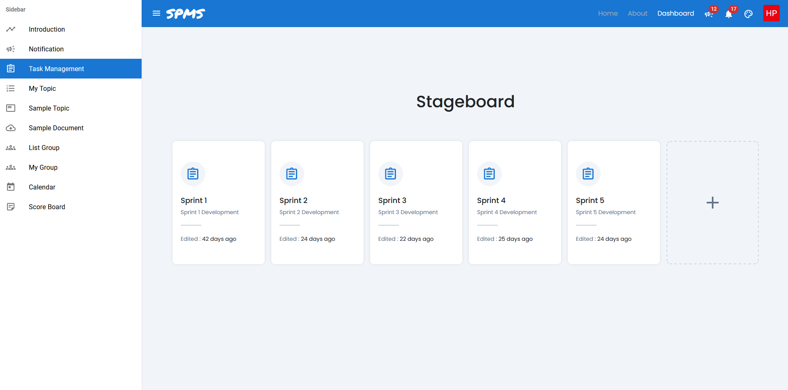
Stage Management

Slide 22
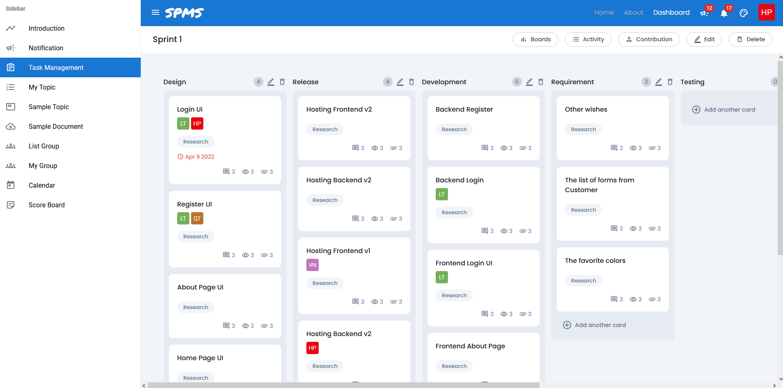
Task Management

Slide 23
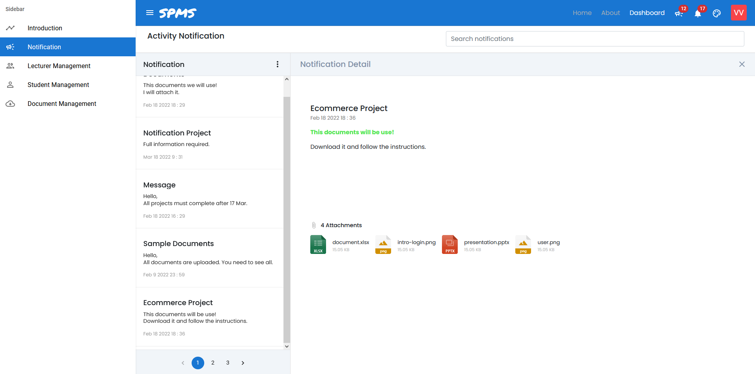
Notification

Slide 24
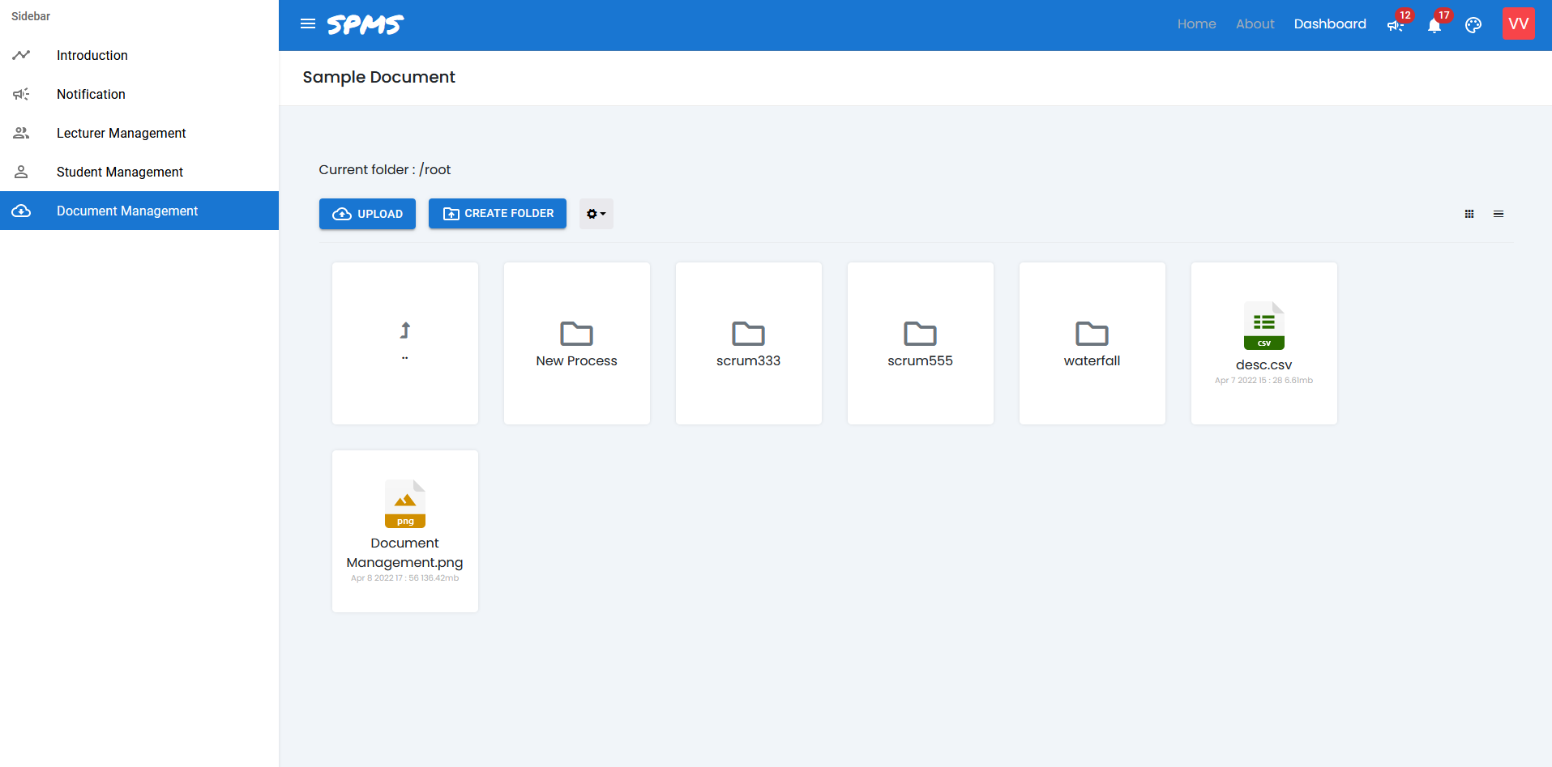
Document Management

Slide 25
Project Management
5

Slide 26
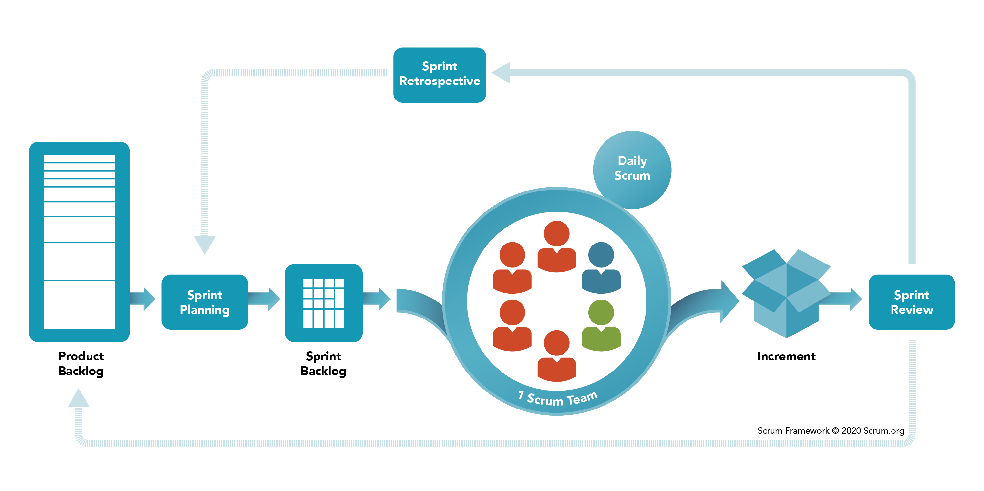
Scrum Process
Scrum is an agile development methodology used in the development of Software based on an iterative and incremental processes.
Scrum is adaptable, fast, flexible and effective agile framework that is designed to deliver value to the customer throughout the development of the project.

Slide 27
Project Phases
Sprint 1
Sprint 3
From: Mar 01
To: Mar 18
From: Apr 14
To: May 01
Sprint 2
Sprint 4
From Mar 19
To Apr 13
From May 02
To May 11

Slide 28
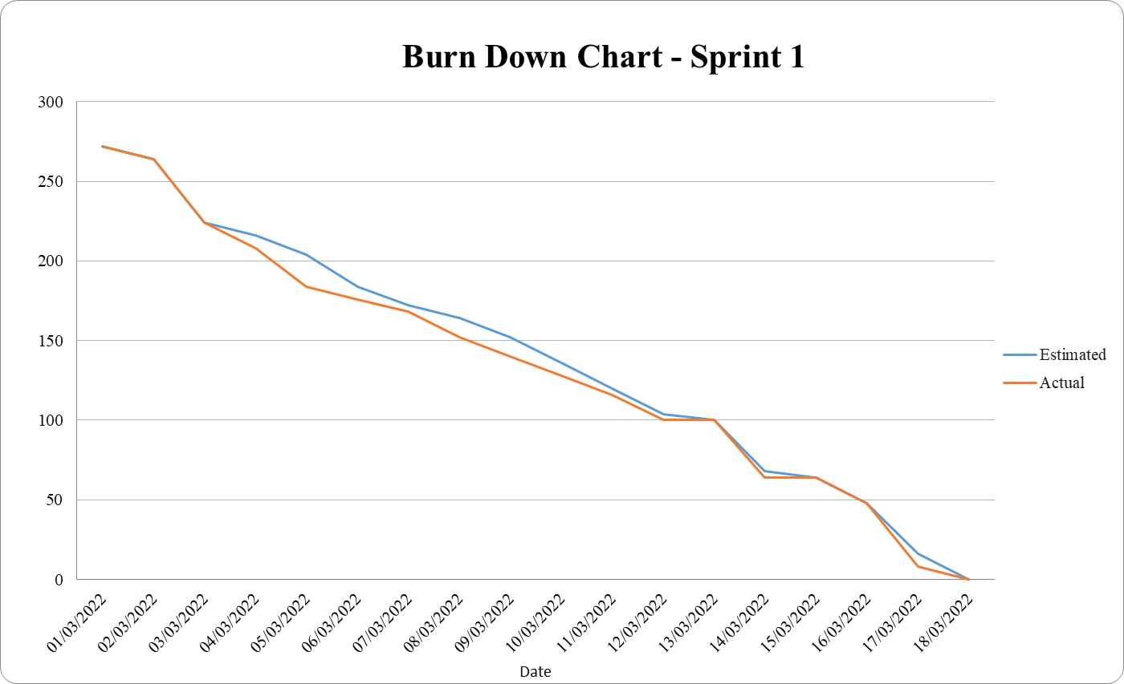
Sprint 1

Slide 29
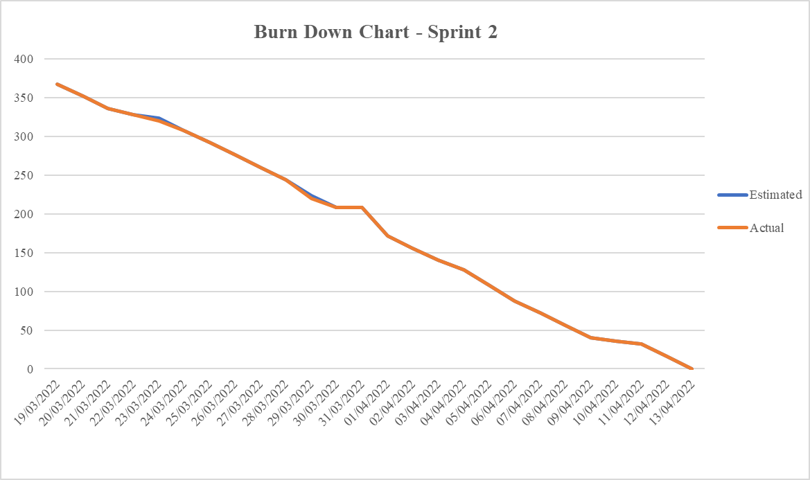
Sprint 2

Slide 30
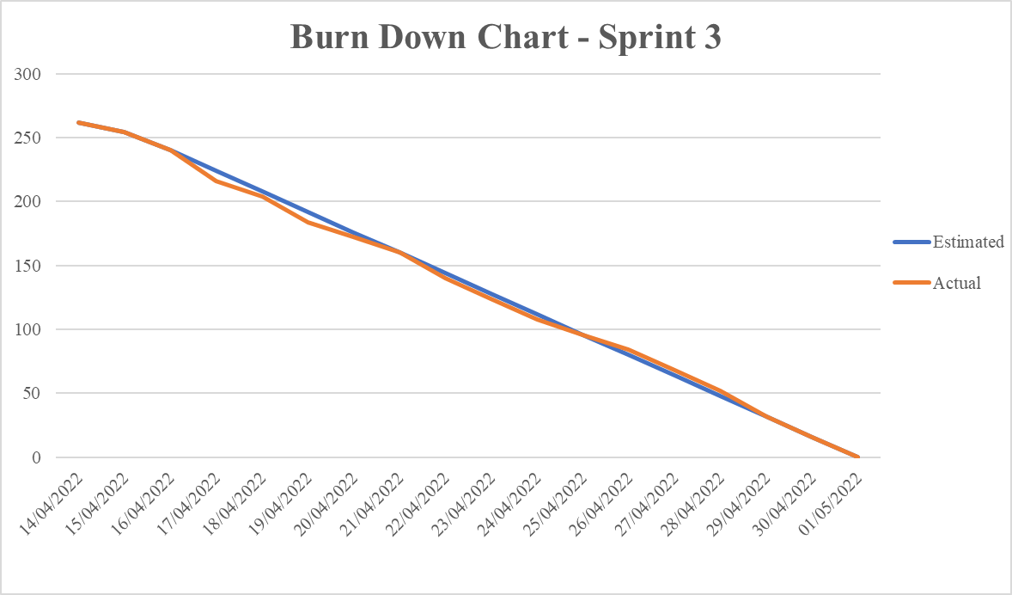
Sprint 3

Slide 31
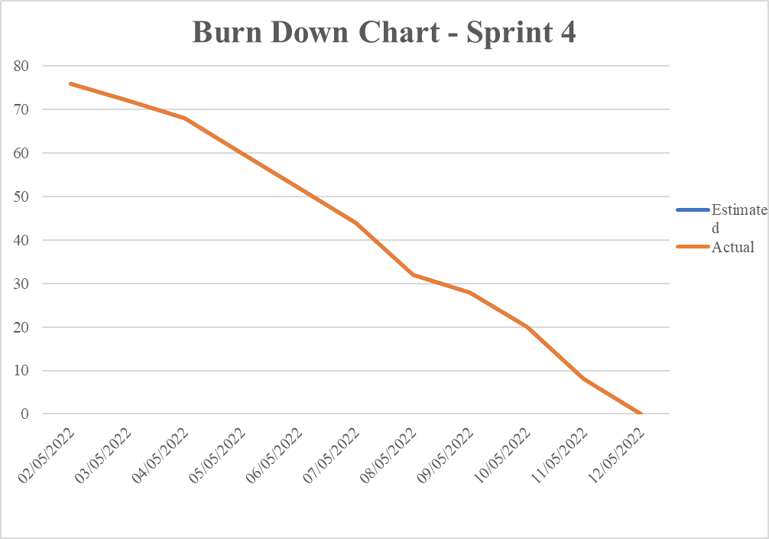
Sprint 4

Slide 32
Reflection
6

Slide 33
Reflection
Understand and apply the scrum process to projects.
Learn new languages and new technologies.
Manage the progress of each stage and task.
Work with the team to solve the project's requirements.

Slide 34
Demo
7

Slide 35
THANK YOU!
Any questions?

